Slide 1
COGNIDRIVE NEXUS
Nimra Amer 21L-5609
Muhammad Hamza 21L-5636
Ahmad Javed 21L-7692
Muhammad Hassan Khalid 21L-5692
Muhammad Ahmad 21L-5617

Slide 2
01. Introduction
02. Project Vision
03. Literature Review
04. Proposed Approach and Methodology
05. High–Level Design
Table Of Contents
06. Conclusion and Future Work

Slide 3
01.
Introduction

Slide 4
Abstract
The "COGNIDRIVE NEXUS" project employs data science to automate the calculation of the time needed for employees to fully own company-provided cars through salary deductions, enhancing efficiency and accuracy in managing employee benefits and ownership transfers. The methodology involves primary and secondary research, utilizing a predictive data science model to achieve these objectives.

Slide 5
02.
Project Vision

Slide 6


Problem Domain Overview
Model predicts time for monthly salary deductions to reach the car ownership threshold.
Considers employee position, salary, leaves, provident fund, and other variables for accuracy.

Slide 7
Problem Statement
The need for an accurate predictive model to estimate the time in months required for an employee's monthly salary deductions to cover the cost of a company car facilitating the timely and efficient transfer of car ownership to employees.

Slide 8

Challenge involves details like job positions, salaries, leaves, and external factors.
Aims to create an adaptable data science model for smart decisions on ownership transfers.
Problem
Elaboration

Slide 9
Goals include machine learning model development, time-series data handling, and model deployment.
Objectives involve data collection, preprocessing, feature engineering, model training, and continuous improvement.
Goals and Objectives

Slide 10
Encompasses historical employee data, positions, salary, car cost, leaves, provident fund, and ownership status.
Predictive model considers a comprehensive set of factors for accurate predictions.
Problem
Scope

Slide 11
03.
LiteratureReview

Slide 12
Predicting car ownership thresholds is crucial for financial planning and HR management.
Particle Swarm Optimization and Neural Networks
Zhang et al. (2023): PSO algorithm + BP neural network enhances car ownership prediction accuracy.
Economic indicators like gross national income and per capita GDP used as input data.

Slide 13
Predicting car ownership thresholds is crucial for financial planning and HR management.
Time-Series Forecasting and Statistical Metrics
Kramar and Alchakov (2023): Focus on time-series forecasting, using statistical metrics (MAE, MSE, RMSE).
Two-layer approach (data preparation and model building) applicable to predicting salary deductions for car ownership.

Slide 14
Predicting car ownership thresholds is crucial for financial planning and HR management.
Leveraging Big Data for Efficiency
"Leveraging Big Data Analytics for Intelligent Transportation Systems" (2023): Big data analytics for vehicle ownership efficiency.
Proposal to improve accuracy in predicting employees' full car ownership, leading to cost and time efficiency.

Slide 15
04.
Proposed Approach and Methodology

Slide 16

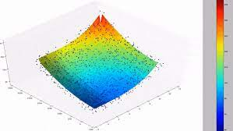
Proposed Approach ?
Regression model for accurate ownership timeframe estimation.

Slide 17

Methodology
Data Preprocessing
Feature Engineering
Model Selection
Handle missing values, outliers, normalize variables.
Time-series data preprocessing for temporal patterns.
Calculate and incorporate various features.
Holistic view of employee's financial situation.
Regression for continuous numerical outcome.
Captures relationships between input features and ownership timeframe.

Slide 18
Methodology
Model Training
Deployment
Continuous
Improvement
Dataset split, model refinement, parameter optimization.
Evaluation metrics: MAE, MSE, RMSE.
Satisfactory performance.
Integrated into existing systems for real-time predictions.
Enhances operational efficiency for timely decision-making.
Periodic retraining.
Adapts to changes in company policies or employee dynamics.
Incorporates additional features or refinements.

Slide 19
05.
High-Level Design

Slide 20
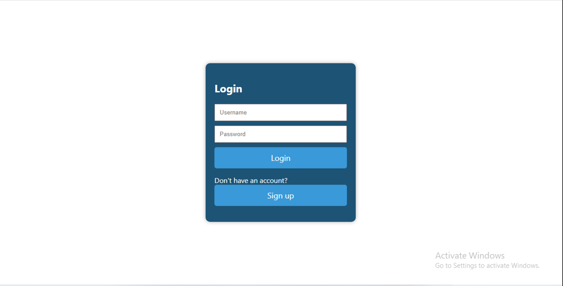

Slide 21
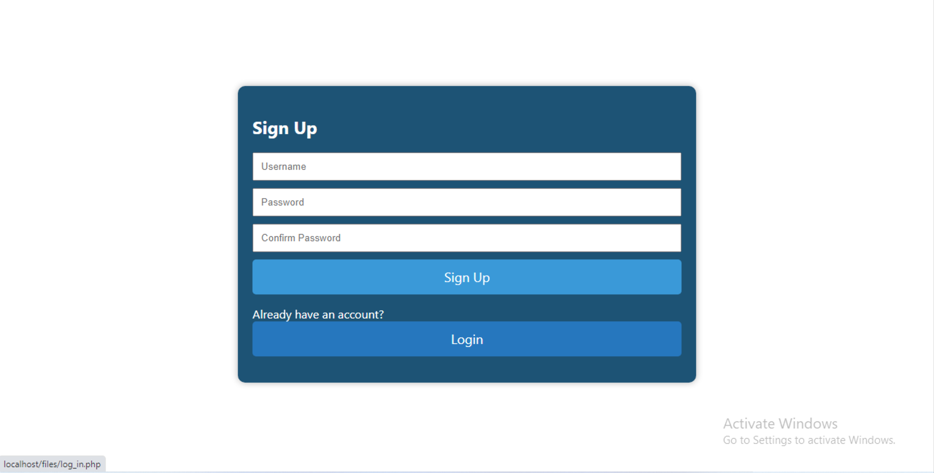

Slide 22
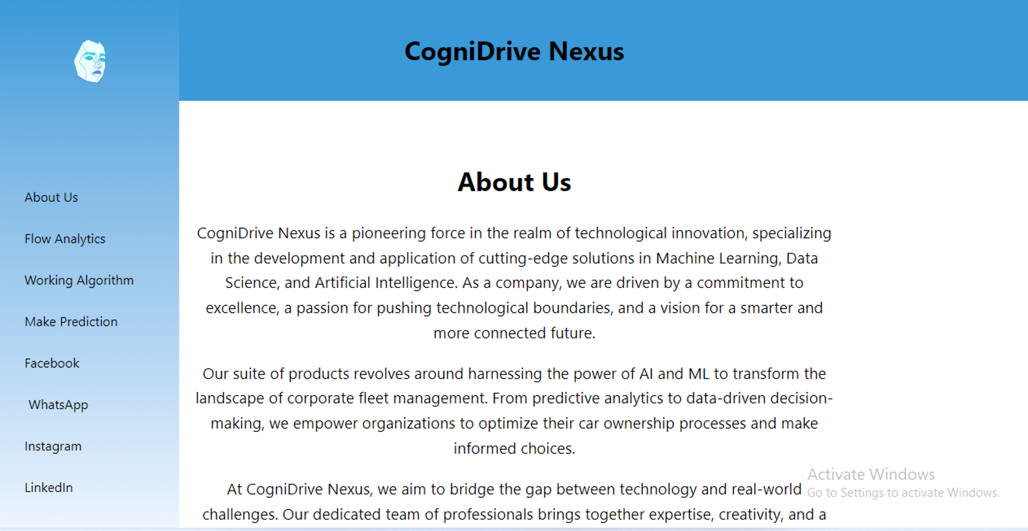

Slide 23
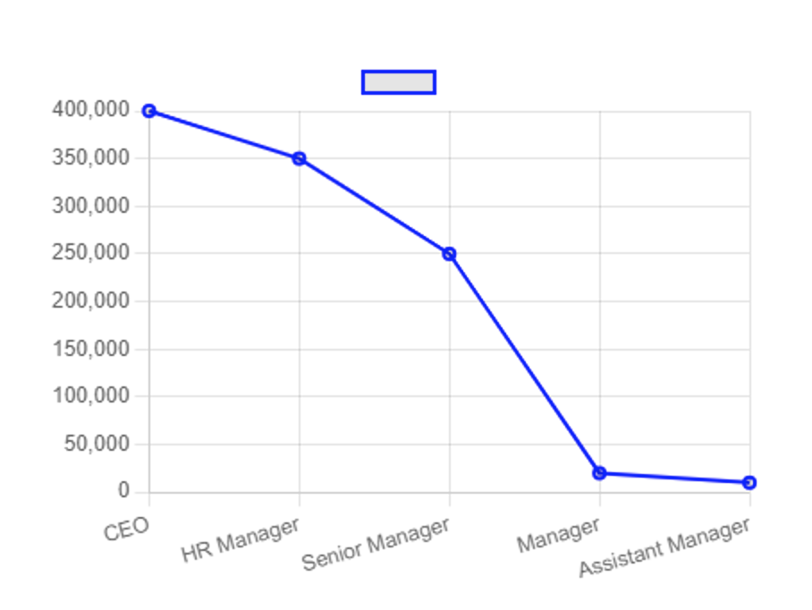

Slide 24
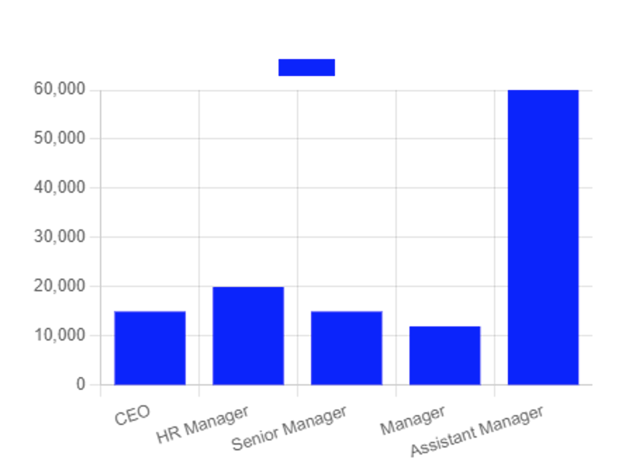

Slide 25
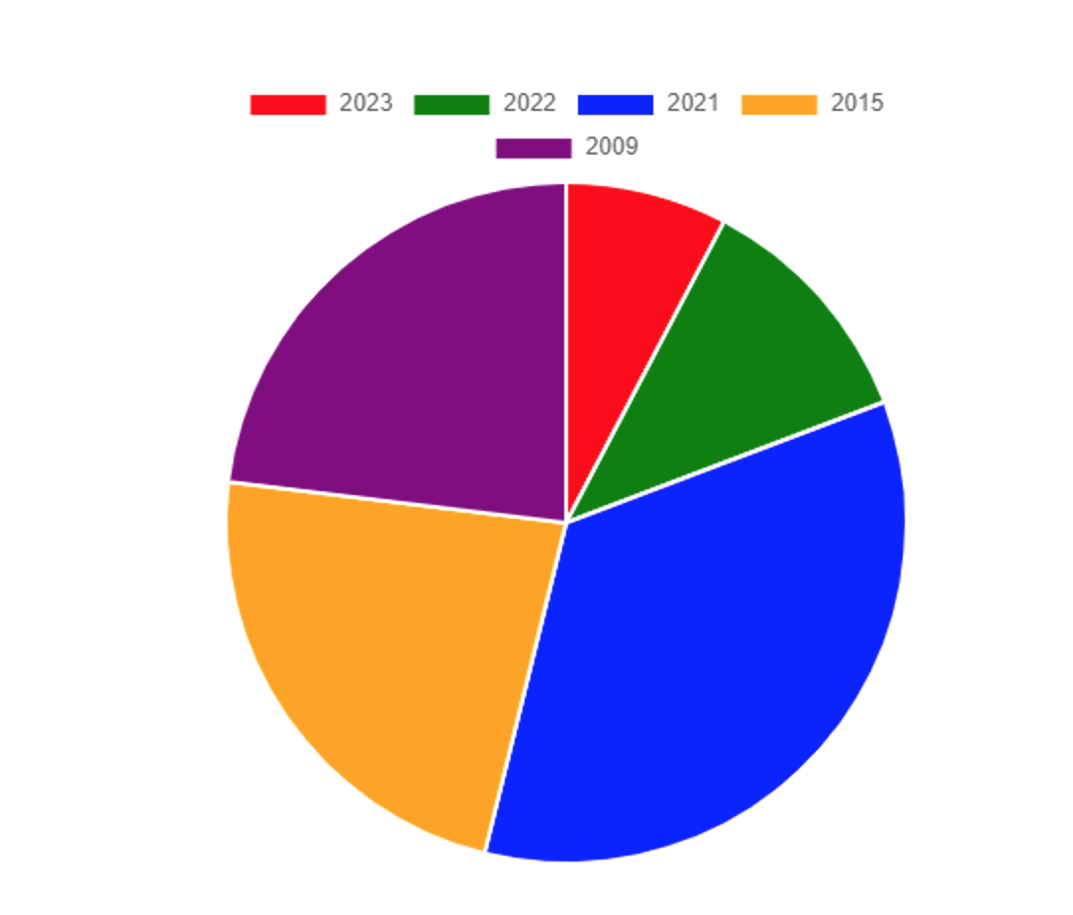

Slide 26
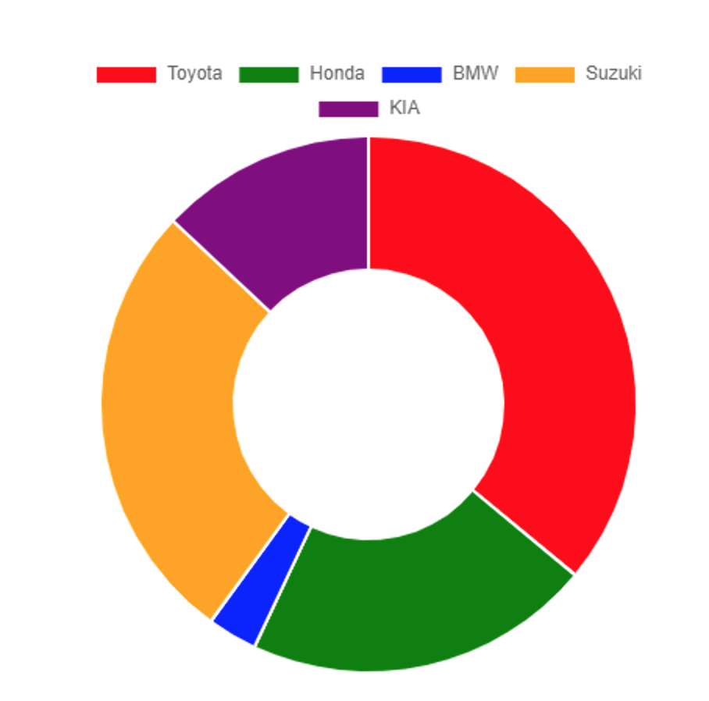

Slide 27
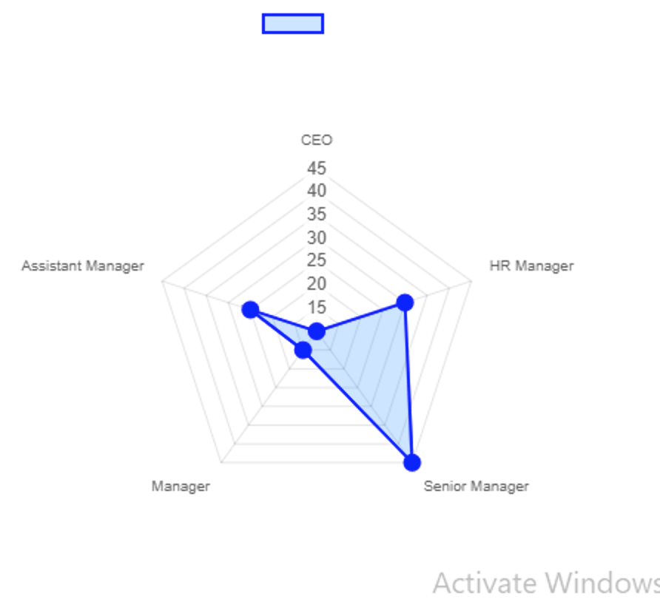

Slide 28
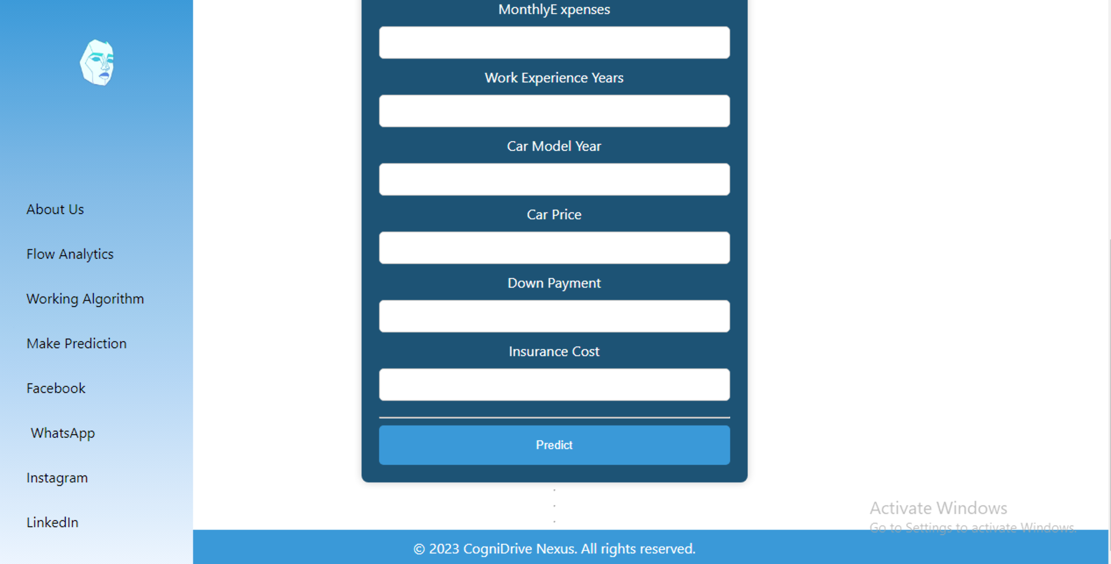

Slide 29
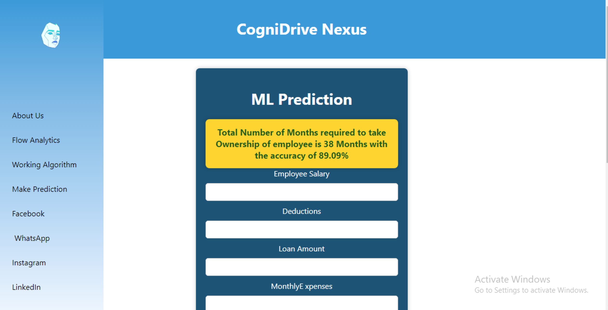

Slide 30
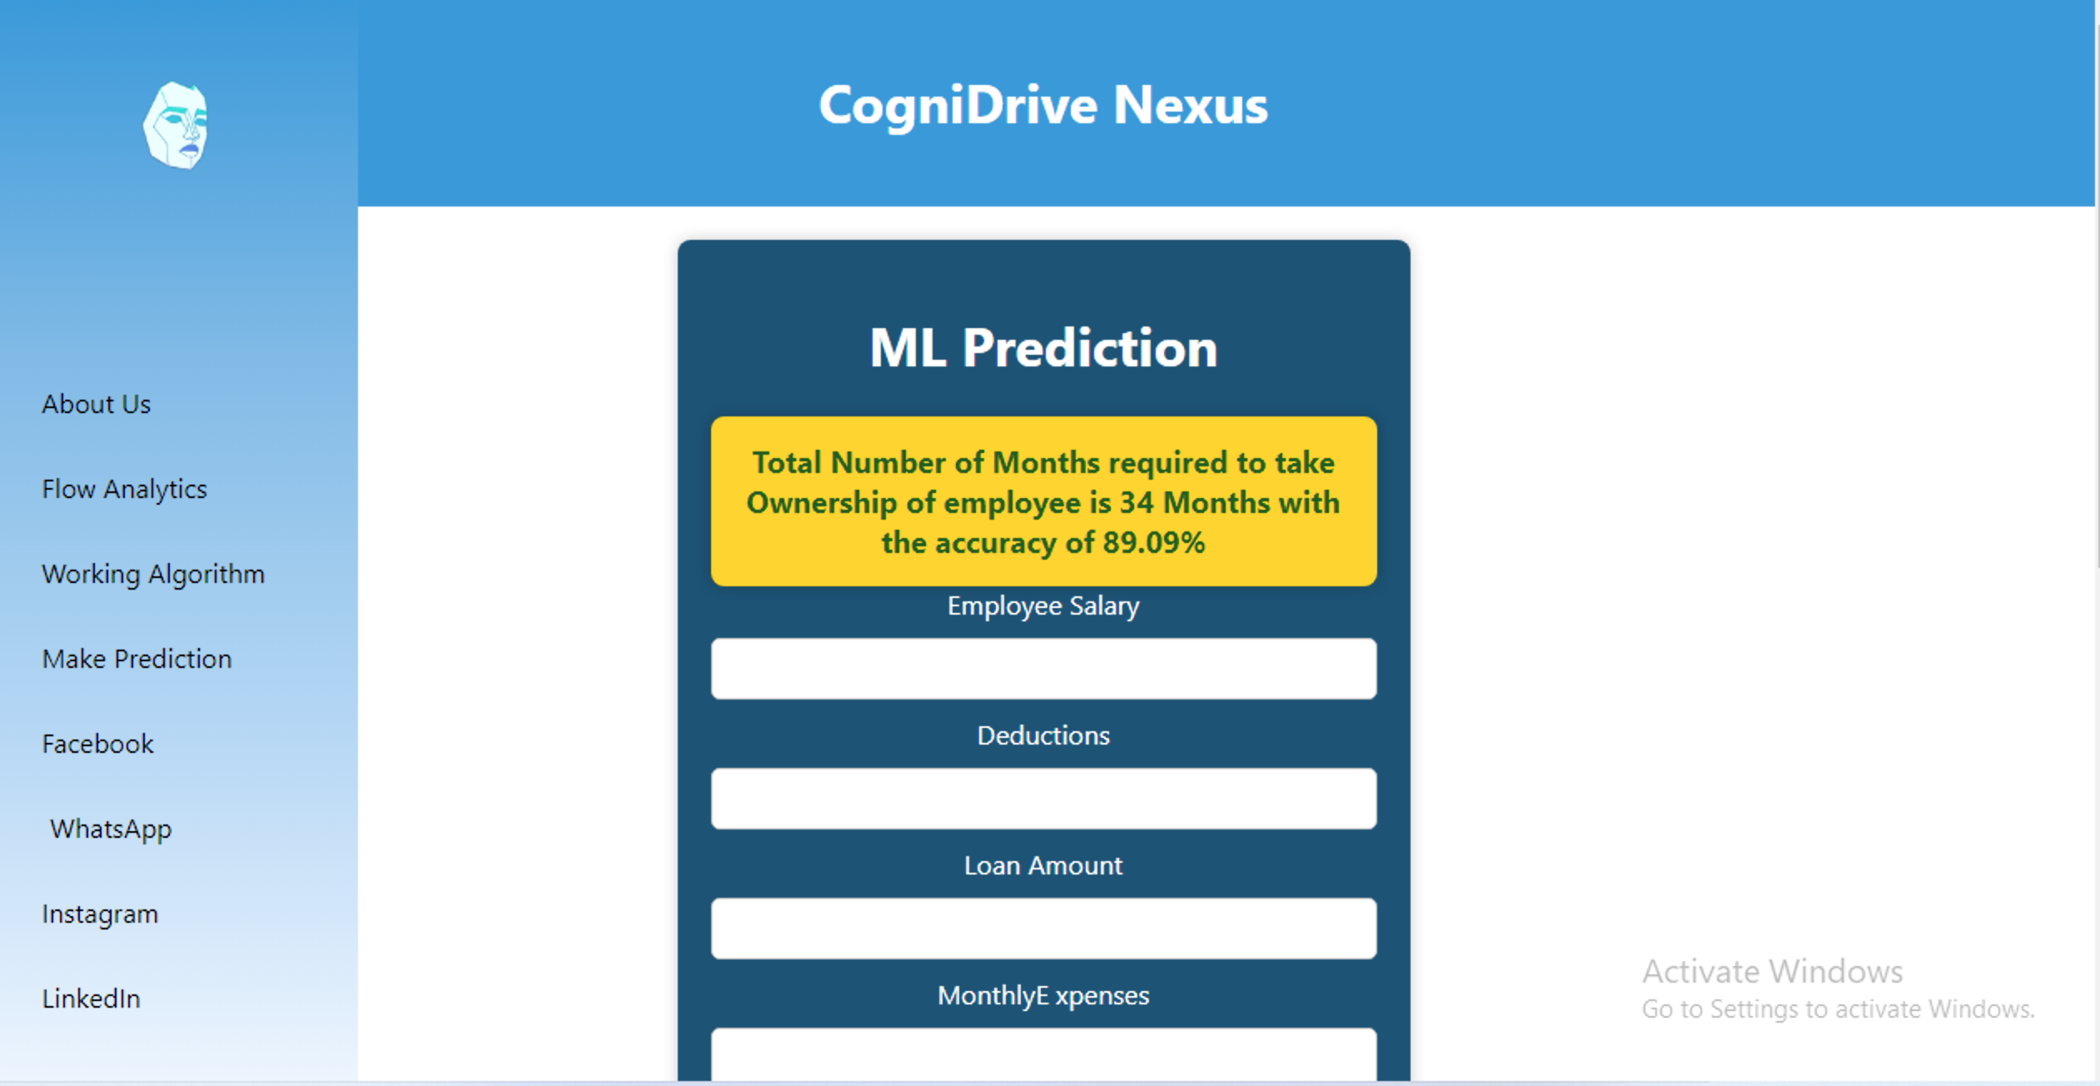

Slide 31
06.
Conclusion and Future Work

Slide 32
Future Work
1
2
3
Explore additional factors (performance metrics, promotions) for improved accuracy.
Integrate real-time data sources for up-to-the-minute predictions.
Gather user feedback for usability and accuracy improvements.

Slide 33
Future Work
4
5
Investigate advanced machine learning algorithms (deep learning, ensemble methods).
Consider expanding predictive model scope to cover broader employee benefits or financial planning.

Slide 34
Conclusion
C
CogniDrive Nexus uses data science to predict time for salary deductions to cover company vehicle costs.
A
Achieved milestone with machine learning, data preprocessing, and continuous improvement.
R
Regression model effectively predicts months needed for ownership transfer.

Slide 35

get in touch
Email
hello@cognidrivenexus.com
Social Media
@cognidrivenexus
Call us
042-111-NEXUS

Slide 36

thank you!
Embrace COGNIDRIVE NEXUS for efficient and predictive car ownership transfers, and join us in shaping the future of streamlined employee benefits administration.

